Slide 1

Next Steps
By
Stephanie Stern

Slide 2

Challenges
The world may look different
Your friends and social environment have not changed
YOU have changed
A lot of people will not be interested in what you have experienced

Slide 3
When the emotional boost dies down…
What will you do then?
What will you remember about this weekend?
Your commitments you made to God?
How will you use this experience to have a closer walk with God?
It all depends on not what has happened but what YOU will do with it, during your next steps.

Slide 4
What if you experience doubt?
Accept the doubt and seek to understand it
Don’t let it defeat you
Doubt does not mean Faith is gone, but it is Faith seeking understanding
Understanding can lead to growth
Look at your doubt as a time of growing in your Faith
Doubt causes us to search for God and seek his will.

Slide 5
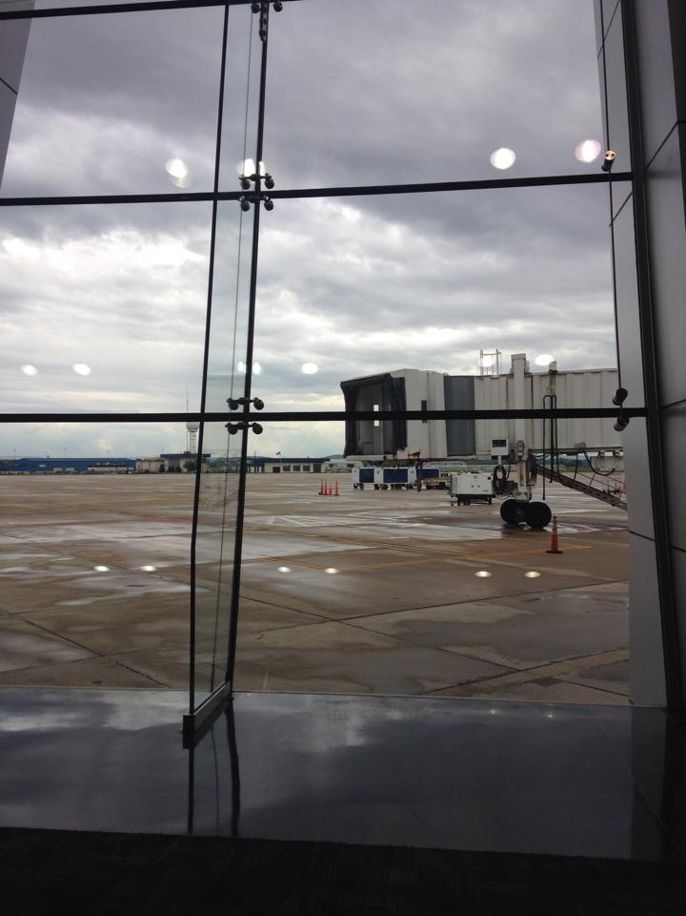
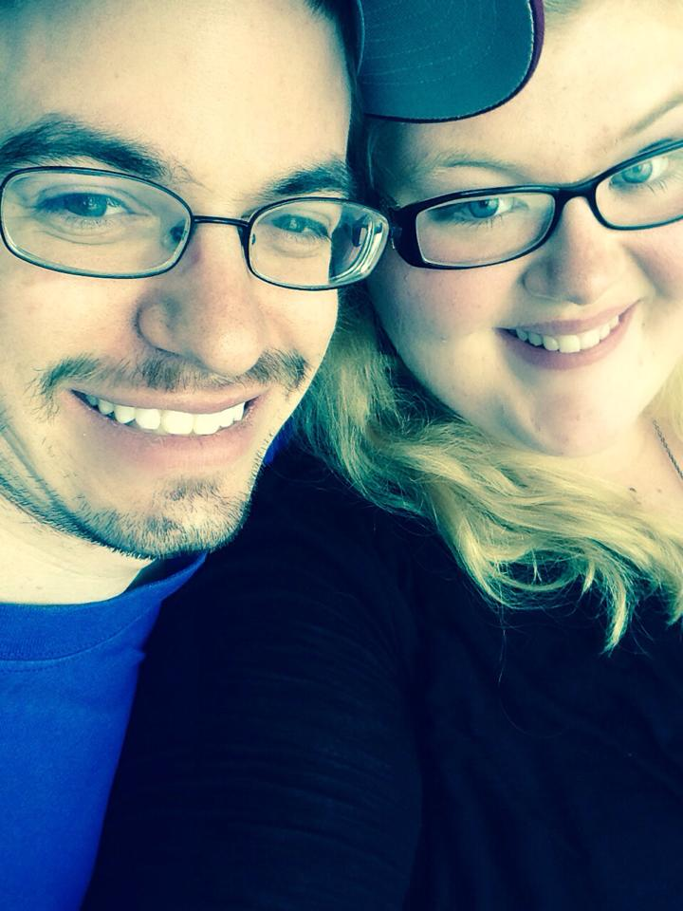

Slide 6
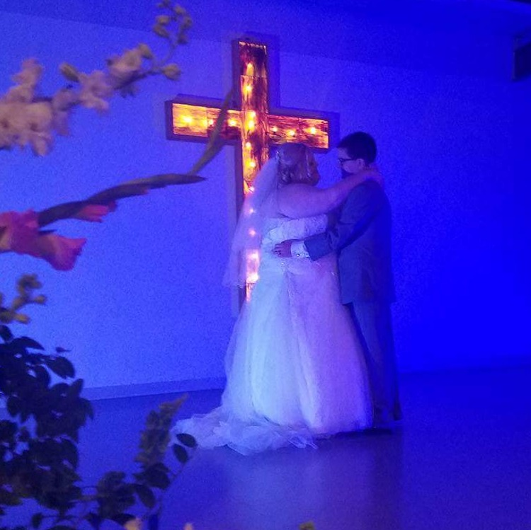
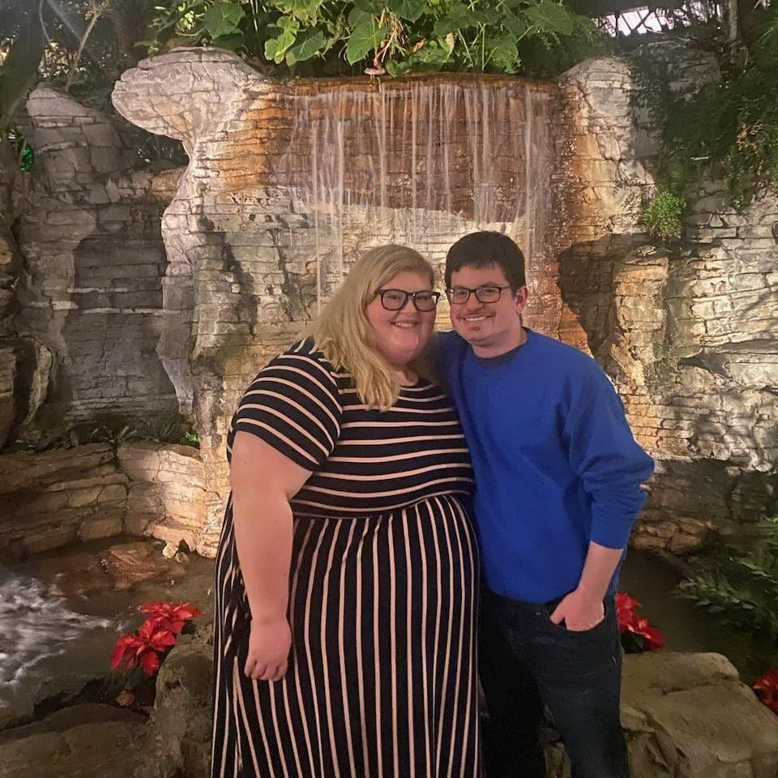
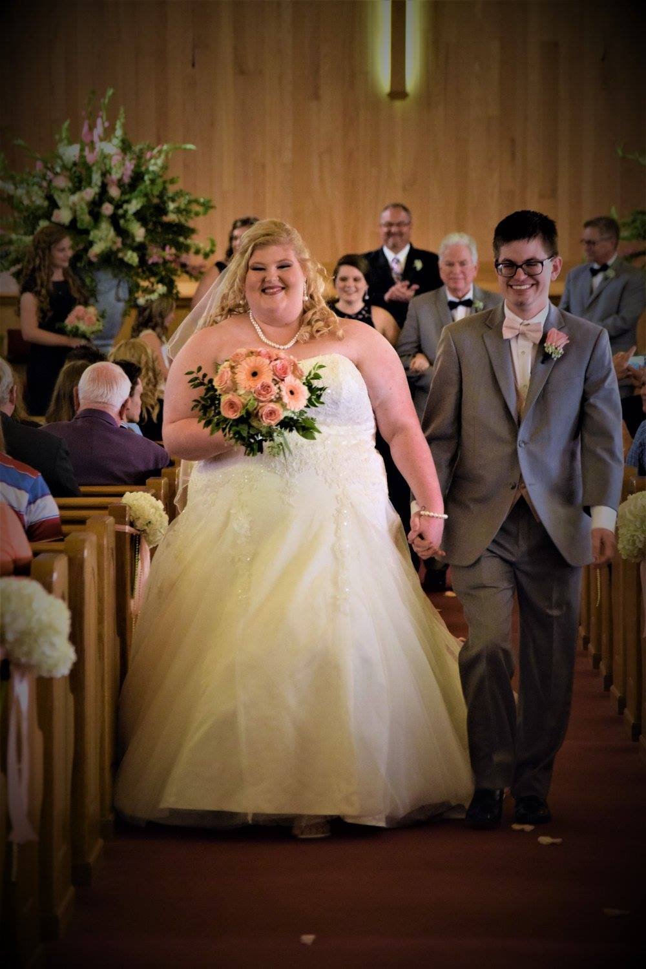
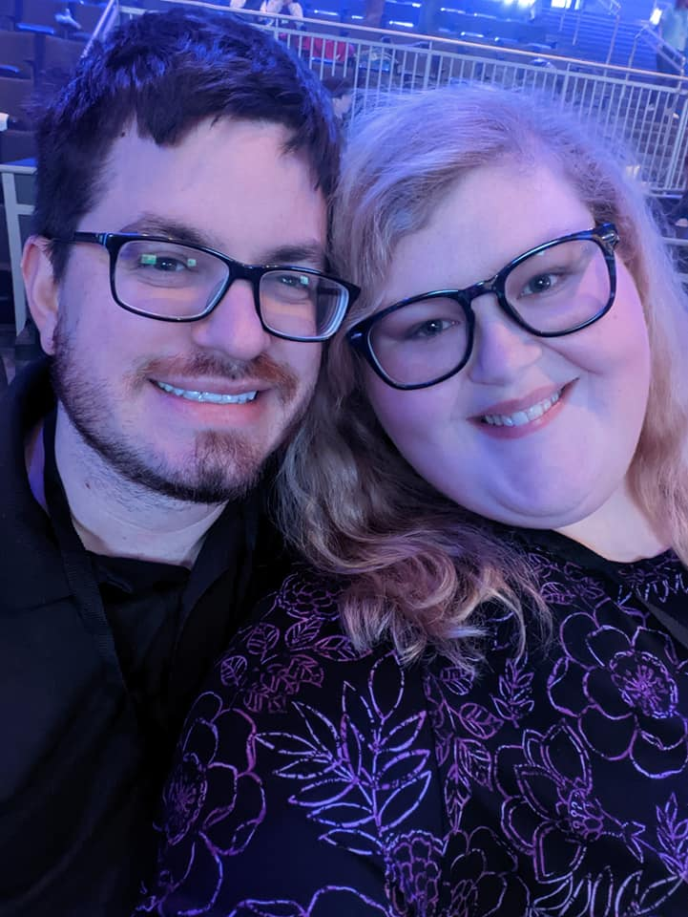

Slide 7
Two Great Dangers
Danger #1
Believing you are better than someone who has not had this experience.
Danger #2
Believing you are nobody and have nothing to bring to the church or to humanity.

Slide 8
Three Essential Spirit Sustainers
Stay in contact with Christ
Jesus said, “Apart from me you can do nothing” (John 15:5)
Keep constant contact with God through prayer and worship, study and Christian action
2. Stay in contact with other Christians
Join a prayer circle
3. Stay in contact with your calling or your God-given purpose in life
Grace is not given to us to keep to ourselves but to share with others

Slide 9
Chrysalis Activity Groups
Chrysalis Reunion Groups
Chrysalis “Rushes” and Emmaus gatherings
Sponsoring other young people for Chrysalis
Supporting future Chrysalis and Emmaus events

Slide 10

Fly
With
Christ!

